Slide 1
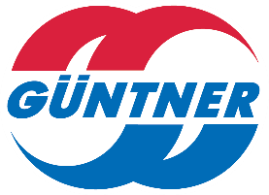

Slide 2
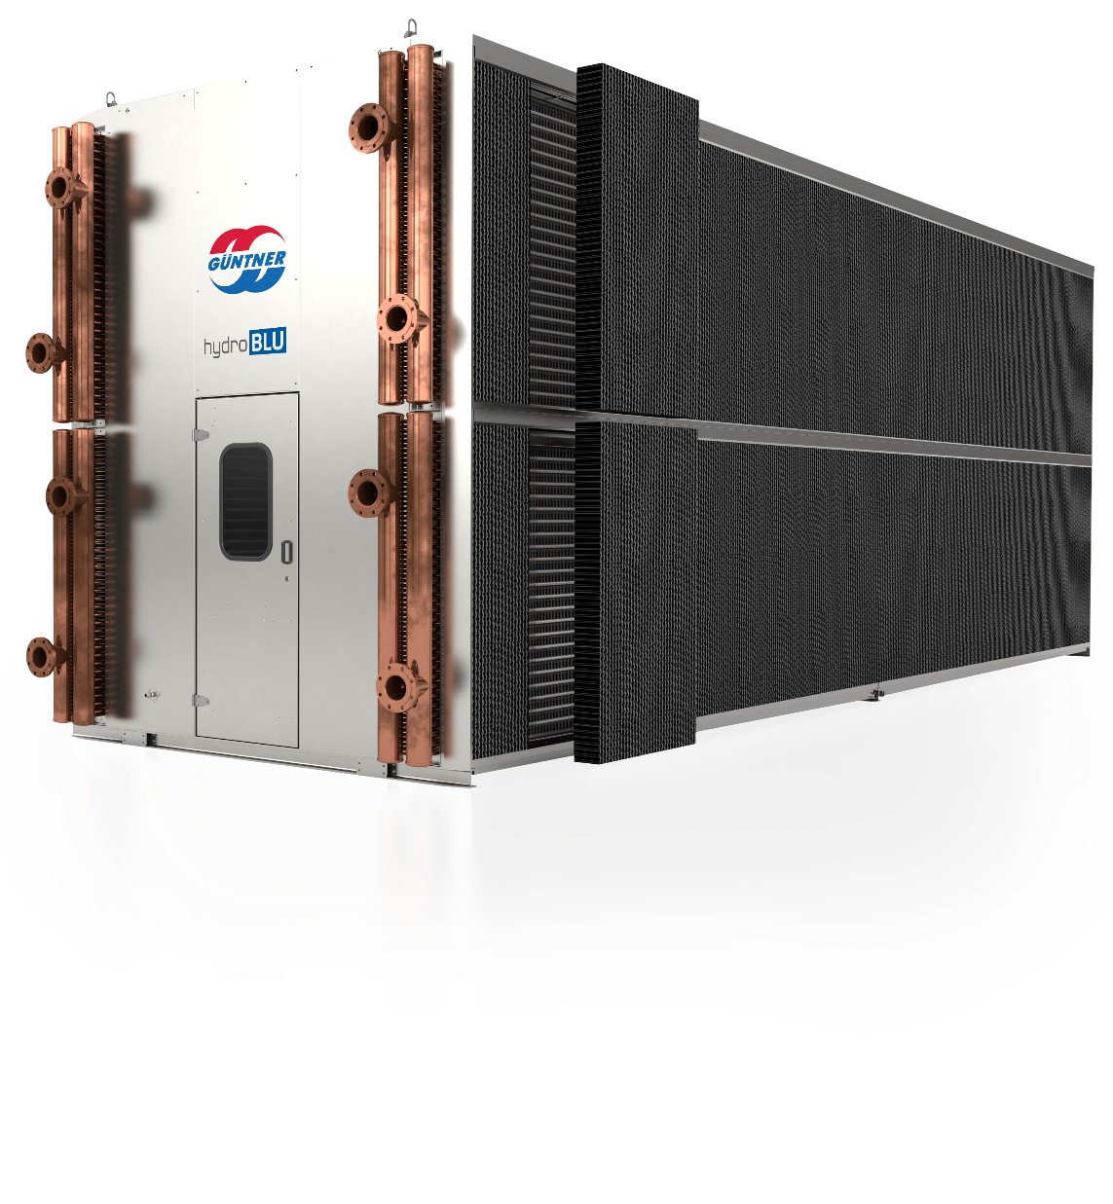
Adiabatic dry cooler high density
AHR PRODUCT OVERVIEW
Jacob Wolfe
Vice President Sales
ASHRAE
February 2020

Slide 3
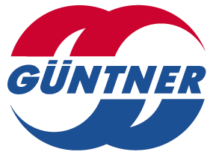
Trends

Slide 4
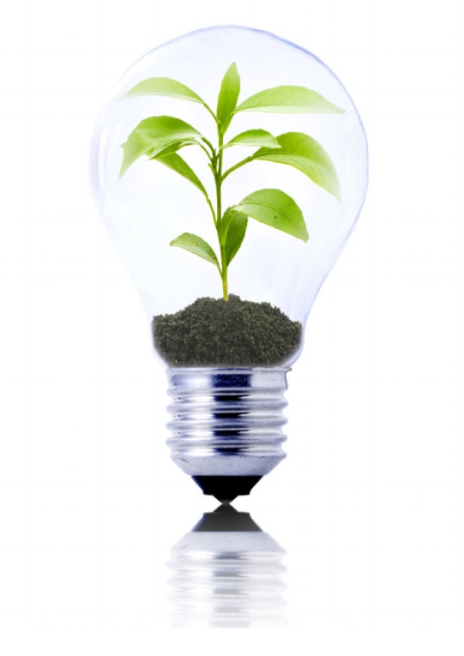
Industry Trends
Water Scarcity
Cost of Water
LEED
Legionella concerns
Water quality
Minimize maintenance
Energy efficiency

Slide 5
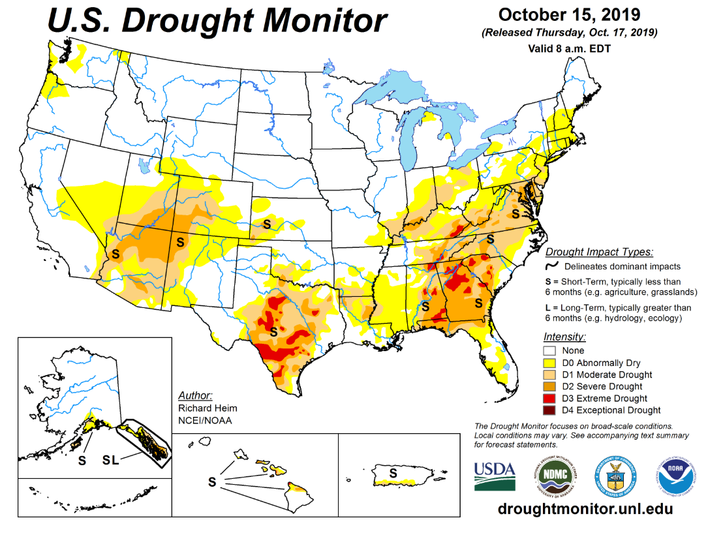
Why Adiabatic Cooling? Availability of Water

Slide 6
Why Adiabatic Cooling? Cost of Water
Commercial Combined Water and Sewer Rates:
National Average: $10.27 per 1,000 gallons*
*Source: AWWA’s 2016 Water and Wastewater Rate Survey
**Source: USDOE Water and Wastewater Annual Price Escalation Rates for Select Cities across the United States
Average Annual Water Price Escalation Rates**

Slide 7
ADIABATIC COOLING

Slide 8
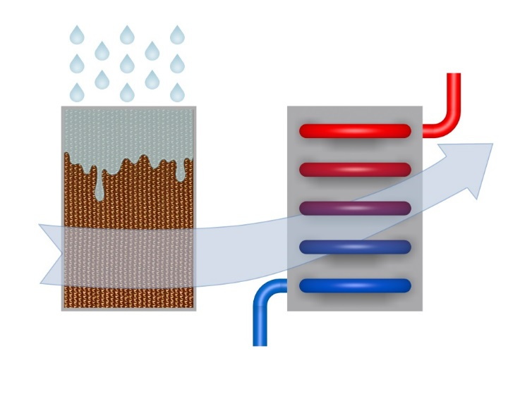
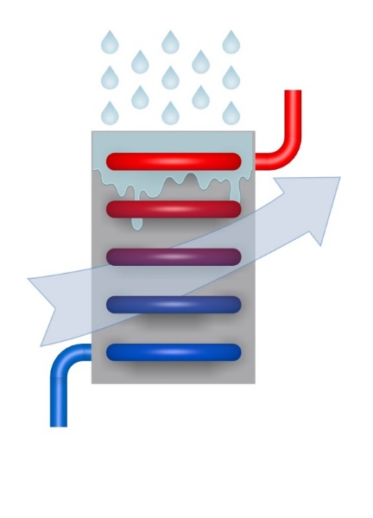
One strong Brand - two technologies
ADIABATIC VS HYBRID
ADC Advanced Dry Cooler
adiabatic
HTK Hybrid High Performance®
evaporation
95°F
90°F
95°F
(T_{WB}72°F)
90°F
95°F
(T_{WB}72°F)
86°F
75°F
86°F
81°F

Slide 9
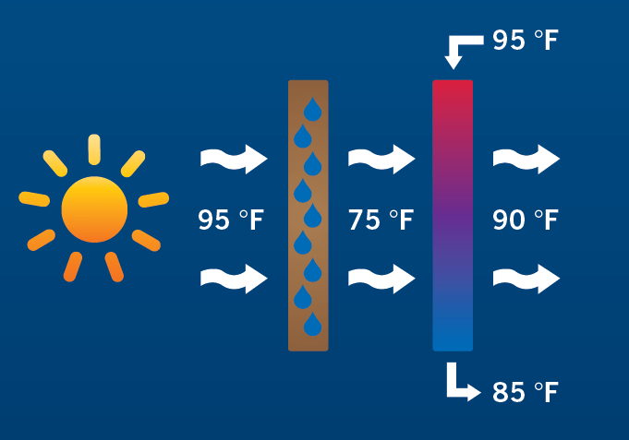
ADIABATIC APPLICATION
WHAT IS ADIABATIC COOLING
Adiabatic cooling reduces temperature without heat exchange
Air moves through a Wetted Pad and is Pre-Cooled Before Passing Through a Dry Coil
Same Premise for Hydro Spray, except Misting Water Before the Dry Fin coil

Slide 10
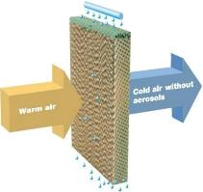
Adiabatic Cooling Delivery System
Wetting Pads
Reliability
Cost
Misting
Adiabatic Efficiency

Slide 11
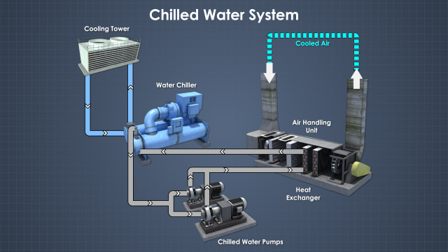
Applications
Heat pump
VRF
Chillers
Data Centers
Geothermal
Free Cooling
CO2
Supermarkets
Refrigeration

Slide 12
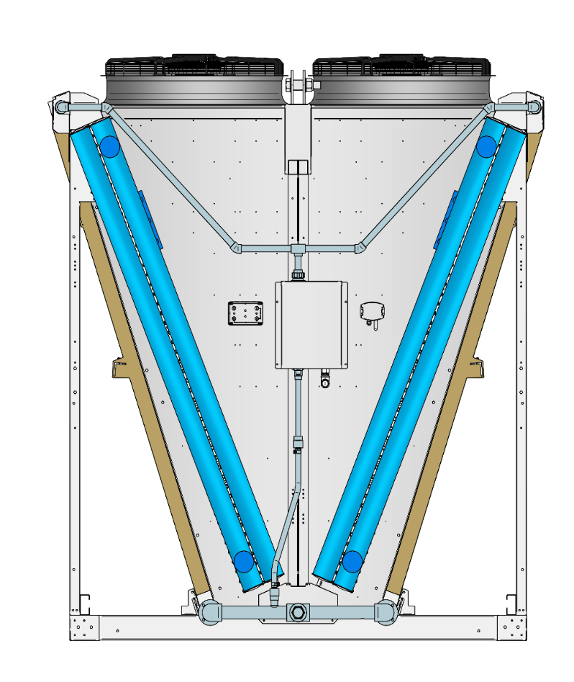
Adiabatic Cooling System (ACS) Components & Schematic
Air Out
Air Out
Fans
Fans
Fluid In
Fluid In
Ambient Air
Dry Finned Coil
Dry Finned Coil
Ambient Air
(Wetted) Pre-Cooling Pads
(Wetted) Pre-Cooling Pads
Water is used on pre-cooling pads during peak hours only
Fluid Out
Fluid Out
Water

Slide 13
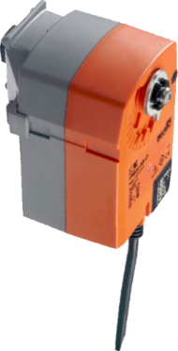
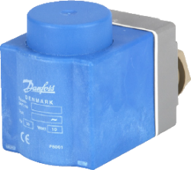
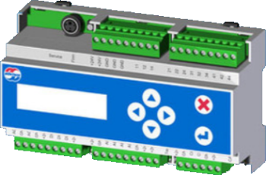
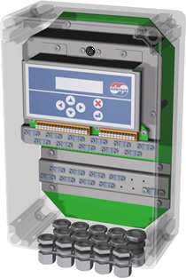
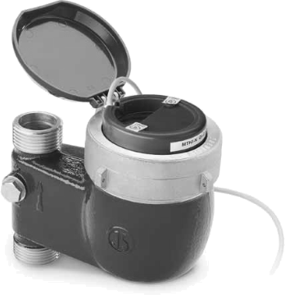
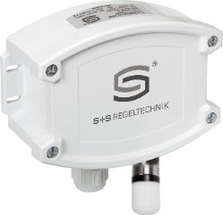
Adiabatic Cooling Systems Control
On/Off Drain
Solenoid
Water Controller
Regulating Valve
Fan Speed Controller
Ambient
Temperature
and Humidity
Water Meter
Fan Speed

Slide 14
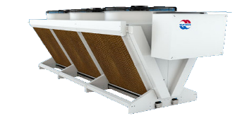
WATER SAVINGS
Ambient-
temperature
Process temperature
Wetbulb
temperature
Ambient
temperature
°F
°C
°F
°F
35
80
95
30
95
75
Design Point
90
90
25
50%
70
20
25%
75%
85
85
65
Allow
Weting
15
0%
100%
Setpoint GMM
80
80
60
10
75
75
Start Wetting
55
5
70
70
50
0
65
65
Fan speed

Slide 15
ENERGY SAVINGS
Ambient-
temperature
Process temperature
Wetbulb
temperature
Ambient
temperature
°F
°C
°F
°F
35
80
95
30
95
75
Design Point
90
90
25
50%
70
20
25%
75%
85
85
65
15
0%
100%
Setpoint GMM
80
80
60
10
75
75
Start Wetting
55
5
70
70
Allow
Weting
0
50
65
65
Fan speed

Slide 16
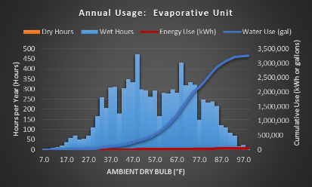
Closed Circuit Cooling Tower Vs Adiabatic Comparison
Resource Consumption
Washington DC 400 Ton System
Annual water and energy cost:
Adiabatic: $16,500
Evaporative: $39,500
Power and Water Rates:
Electricity rate $0.08 $ / kWh
Demand charge $8.24 $ / kW / mo.
Water & sewage $10.00 $ / kgal
Water treatment $4.00 $ / kgal

Slide 17
ADC High density

Slide 18
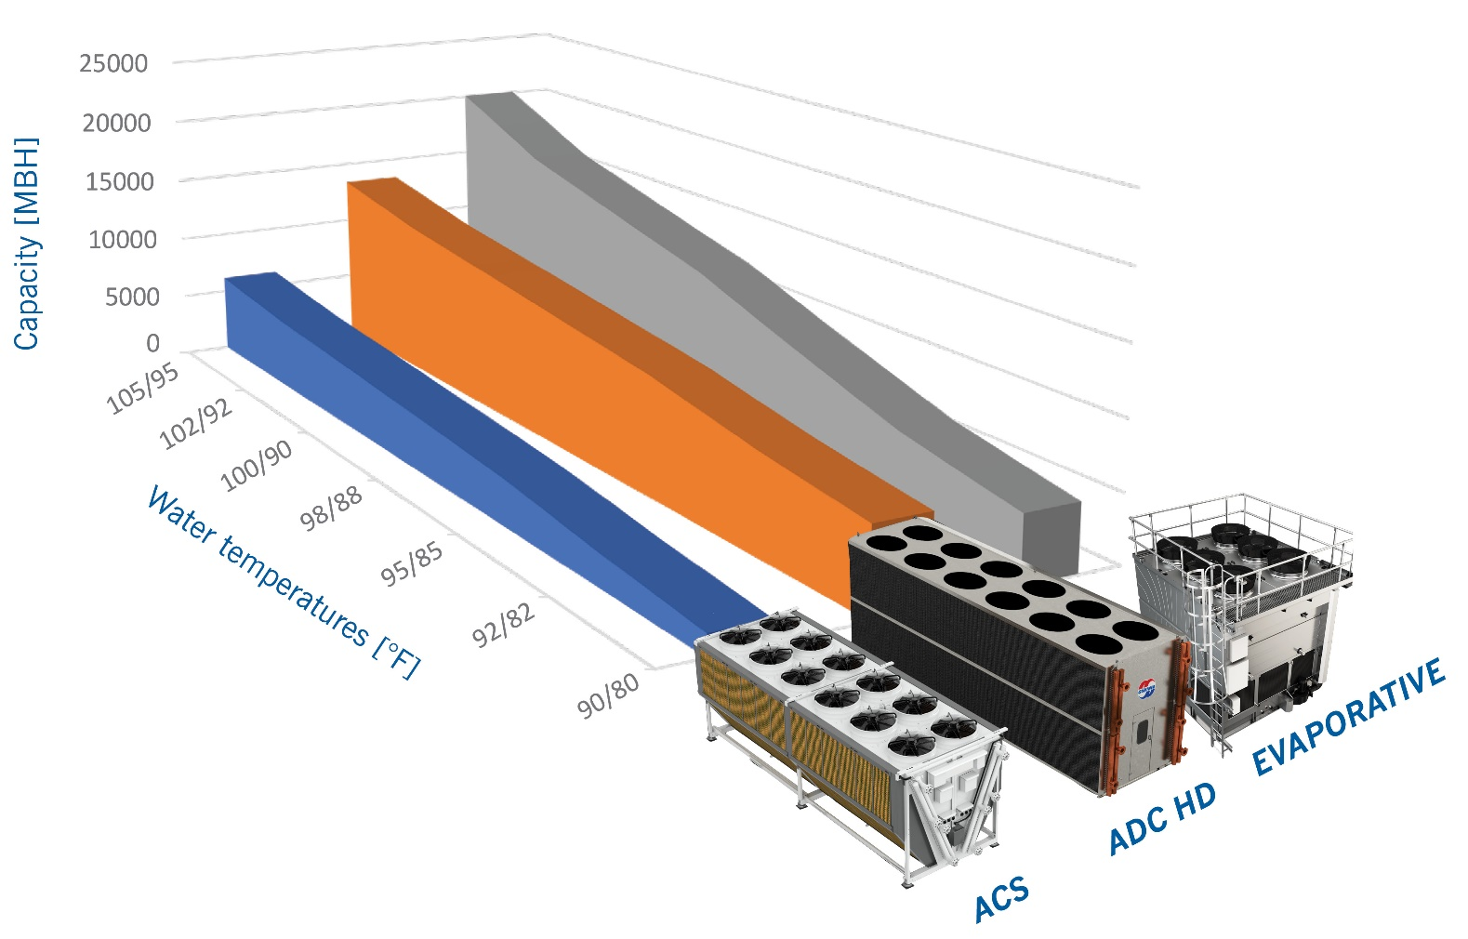
ADIABATIC Comparison

Slide 19
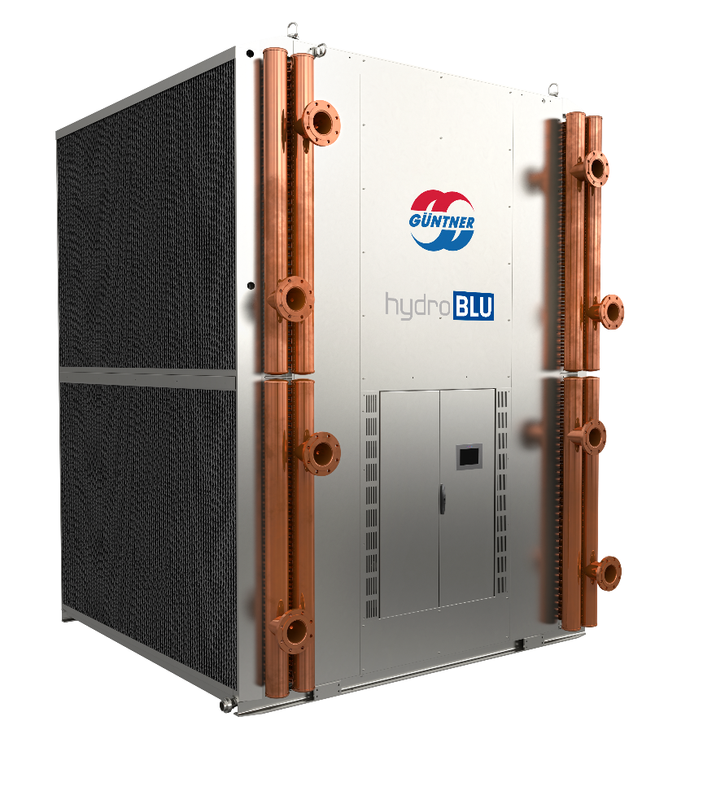
ADIABATIC DRY COOLER HIGH DENSITY
EC Fan Motor Technology
HydroBLU Water Metering Controller
Customized for USA Transport
Hygienic operation
Dry Cooler or Condenser
OSHA approved walkway

Slide 20
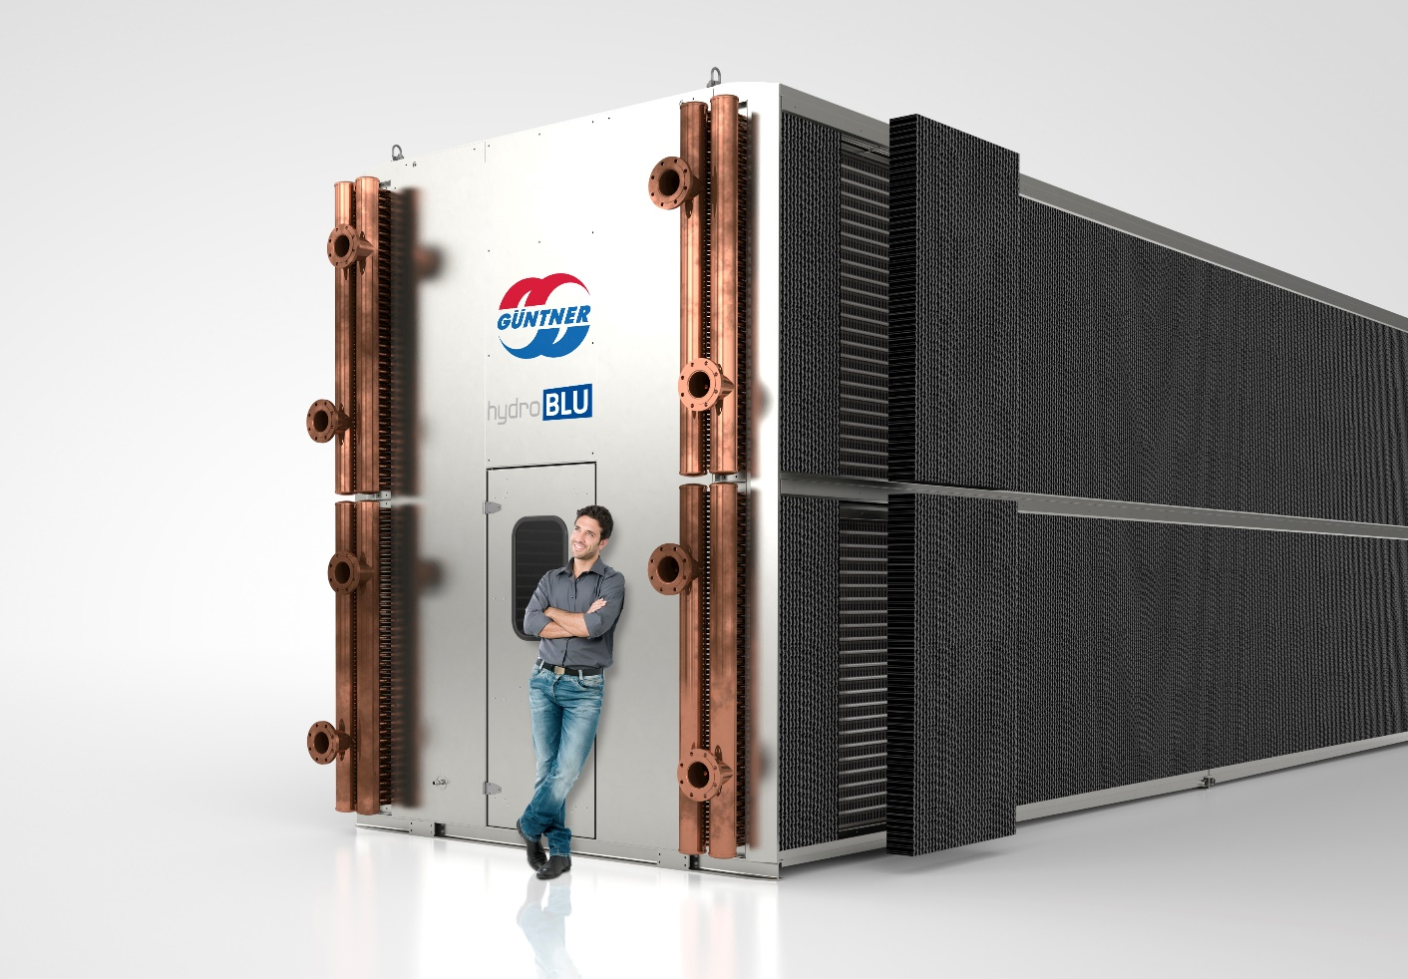
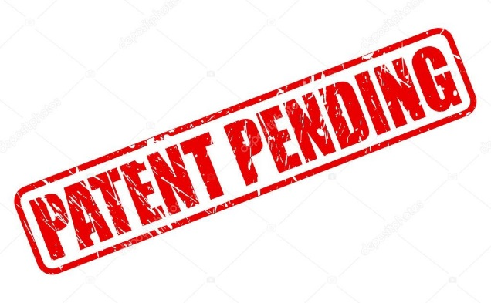
Adiabatic dry cooler high density
How is it build
1. EC Fans
2. Heat exchanger
3. Air Flow
4. Supply
5. Return
6. Wetting water inlet
7. Humidification pad
8. Wetting water outlet
Adiabatic Dry Cooler High Density
Maximal thermal performance with a small footprint
10

Slide 21
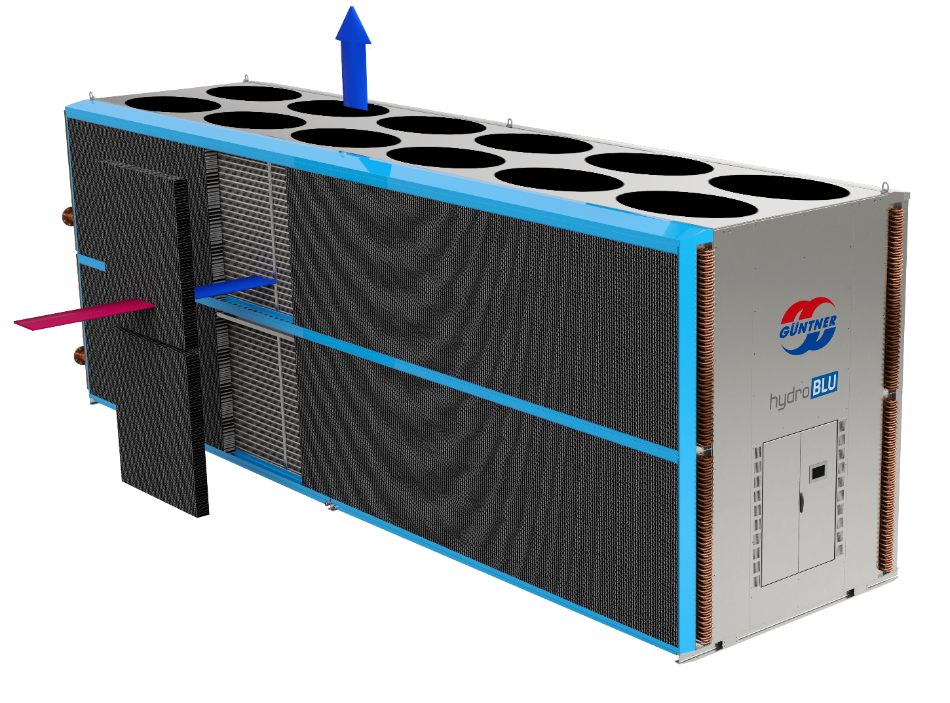
HOW IT WORKS
Adiabatic operating principle
Güntner Adiabatic Dry Cooler or Condenser High Density can be used either wet or dry.
Higher Pad Efficiency giving High Density Cooling very close to Wet Bulb
Adiabatic pre-cooling boost performance
For high outdoor temperatures and heavy system loads
10

Slide 22
Güntner Products
FOR EVERY APPLICATION
Cooler
Condenser / Fluid cooler
wet
Controls
dry
Service

Slide 23
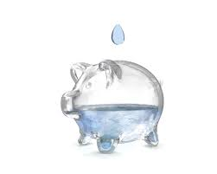
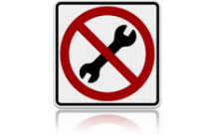
Why Güntner?
EARTH FRIENDLY – GREEN – SECURITY - RELIABILITY
Dry Coolers
Integrated Guntner controls
Energy efficiency
EC Motors
Reliability and Low Sound
Simple effectiveness of dry cooler
Minimal maintenance
Eliminate water treatment
Minimize winterization concerns
Mitigate risk of Legionella
+ Adiabatic
Water savings typically 60% to 90% (+) vs evaporative
Optimize water and/or Energy Usage
Easily replaceable pads
No plumes
No water recirculation
No pump
No aerosolization

Slide 24
Questions?

Slide 25
Your Contact Person(s):
Jacob Wolfe, LEED AP
Vice President Sales
Office: 847-781-0900
Cell: 717-668-1154
Email: Jacob.Wolfe@guentner.com

